Slide 1
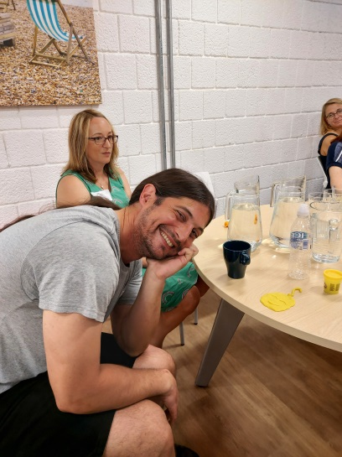
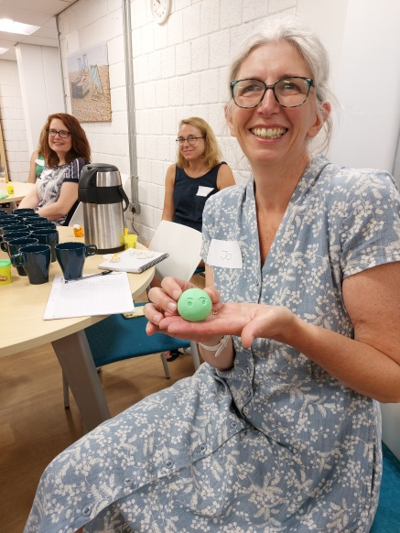
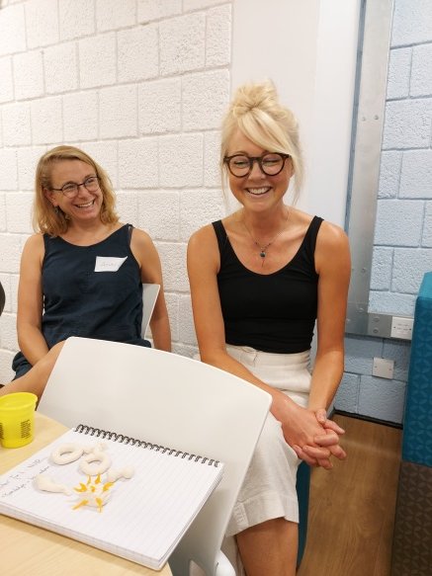
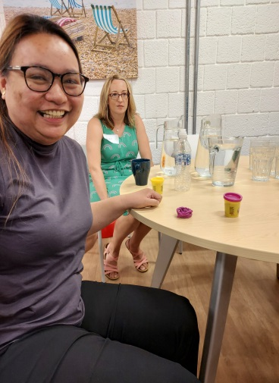
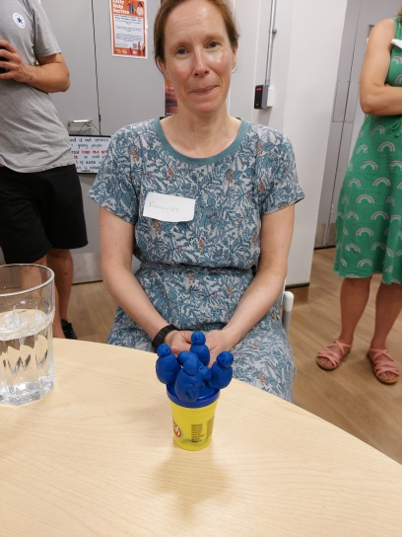
A Creative Way to Nurture Research Careers: Capturing the Magic
Louise Goodall
Programme Lead for Chief Nurse Fellows
Notes:
Looking at research careers using individual, organisational and national perspective. Using the CNF Programme as a recent example of way to encourage NMAHPs across NHS Sussex into research careers - the CNF will continue but we want to capture the magic of the CNFs and work it into a broader plan for engaging healthcare professionals in research across NHS Sussex
Explain CNF Programme: 1 year long, took 3 cohorts over 2 years of 13, 16 and 16 healthcare profs, 1 year backfilled for 1 day a week with supervisor, money for development, teaching input on QI, leadership, change management and EBP
and how we are going to use the successful elements of the programme to provide a broad range of opportunities for healthcare staff to become engaged in research
Two threads: Your project
Yourself – personal development, MSc/PhD/ leadership and career development
Four phases to the year: lit review, QI, change, leadership

Slide 2
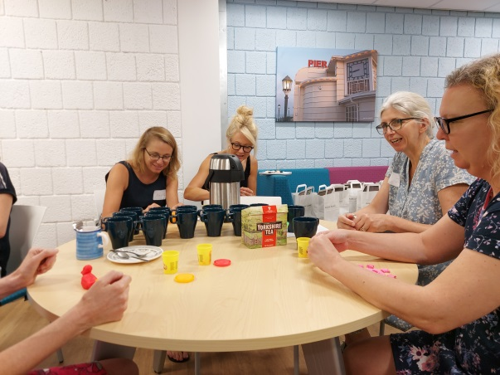
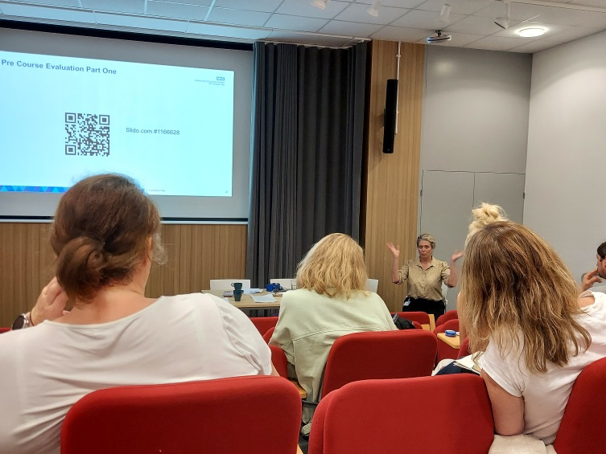
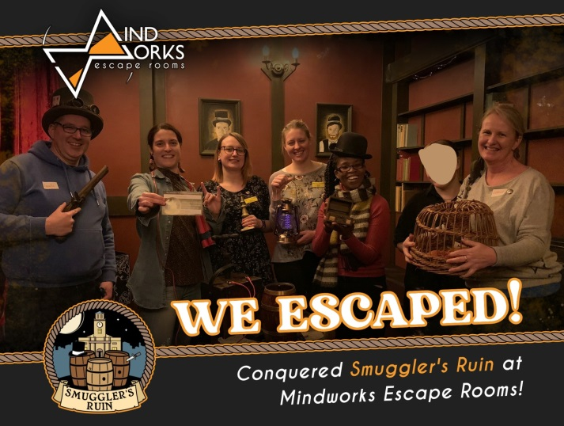
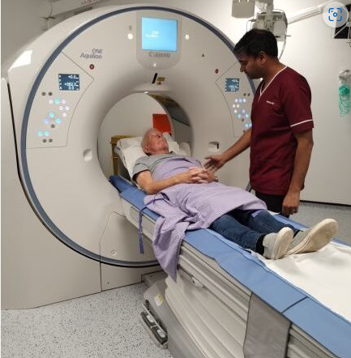
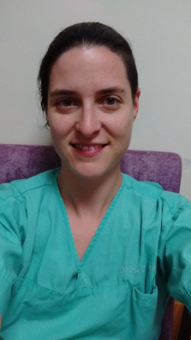
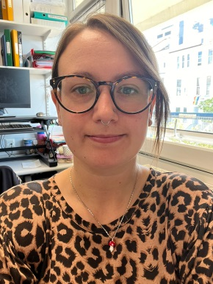
Individual Perspective
Notes:
Interprofessional learning
Personal development: autonomy, belonging, contribution
Leadership
QI
Examples of projects:
Helen Crook, orthoptist = pt experience
Usman Raza, radiographer = pt safety
Laurie Benn, nurse = pt safety, retention of students
Zamira = improving birthing experiences = pt experience
Felicity nurse = pt experience
Andre biomed scientist = speeding up analysis of blood results – pt experience
Nikki Dent physio = cancer prehab
Anne E – physio – optimising recovery in neuro rehab
Madona nurse – staff levels and patient acuity
Helen J – OT – Sensory interventions for adults with learning difficulties
Creating futuer leaders with clinical academic and leadership skills to embed and lead change
The best ideas come from clinical practice, retaining a clinical focus

Slide 3
Notes:
Impact measurement – both in numbers and experiences
Numbers above
Experiences – lighting fires around them, engaging colleagues in their projects and also their personal development eg developing journal clubs, networking outside the Trust, individual exposure and growth, growth of networks, QI ability and expertise as a hc prof – having an area of expertise
Developing talent – leaders of the future learning skills at the bedside

Slide 4
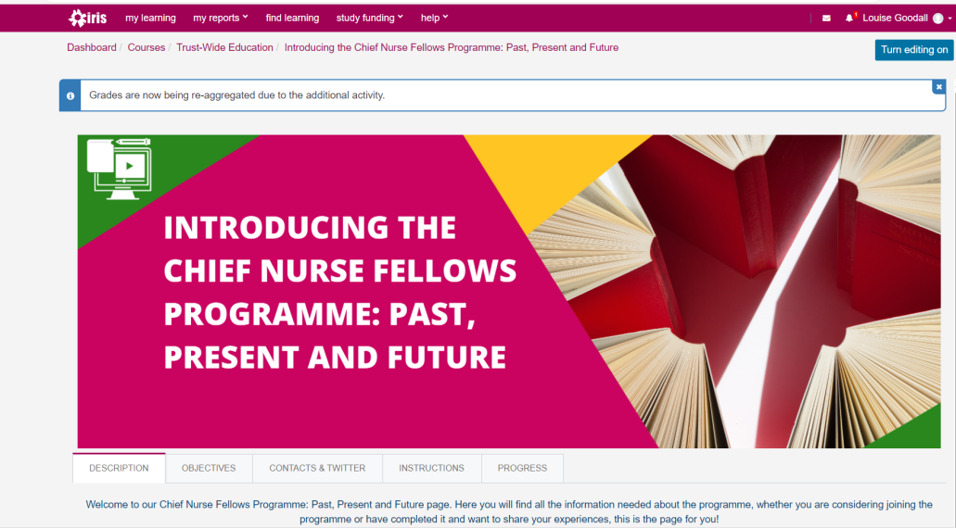
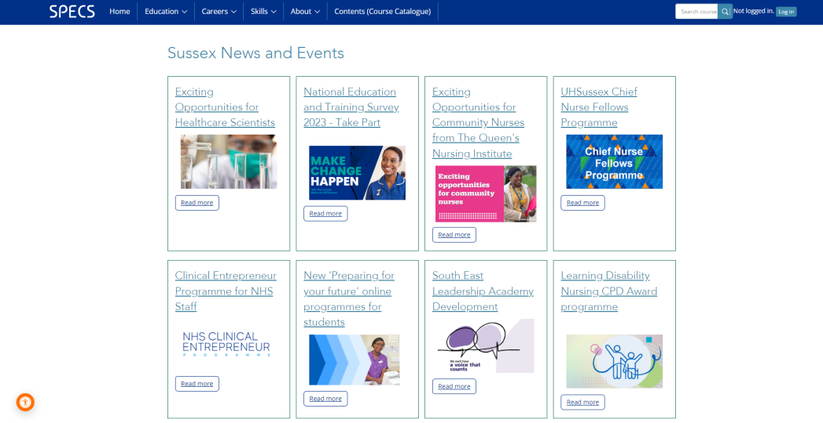
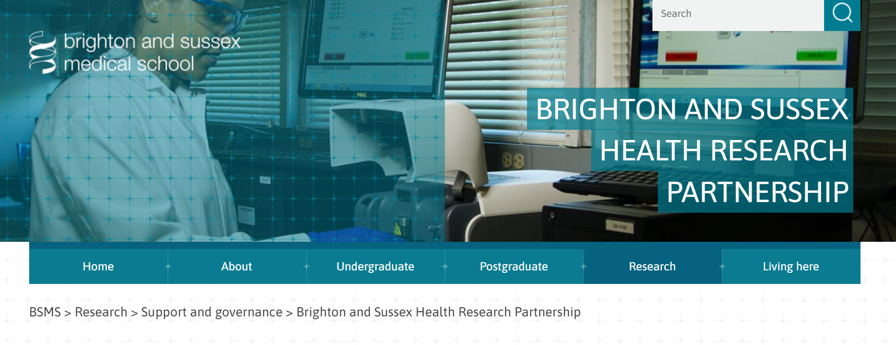
Healthcare Organisation Perspective
Notes:
CNF Prog is Guided by :
Chief Nurse eg broadening out to NHS Sussex, developing academic careers
Research and Innovation Strategy
Projects link to:
UHSussex Patient First Vision:
The patient has to be at the heart of everything we do
Our services must be sustainable
We need to attract and keep the best people
We have to strive for the very highest quality
We must work with the wider system and our partners
We should invest in research so we can use innovation to drive our improvement
Alumni feedback, supervisor feedback
Retention of staff – career opportunities created, retaining motivated clinically focused, developed staff as leaders, improving care through quality improvement
Partnership working across UHSussex and NHS Sussex
Lighting fires, generating interest, creating alumni, networks across the system
Alumni
Links to Sources:
CNO Chief Nursing Officer for England’s Strategic Plan for Research. 2021. V2. B0880-cno-for-englands-strategic-plan-fo-research.pdf
Council of Deans of Health. 2018. Nursing, Midwifery and Allied Health Academic Research Careers in the UK. www.councilofdeans.org.uk
Health Education England. 2022. Developing a Flexible Workforce that Embraces Research and Innovation. www.hee.nhs.uk
University Hospitals Sussex. 2022. Patient First Strategic Themes www.uhsussex.nhs.uk/about/patient-first/
https://padlet.com/loubeegee/uva3t0hv4en2f6rb
Also would be good to have link to:
Interviews with Managers and Patients about the impact of the CNF role
Interviews with past CNFs
How to book an appointment with someone for career coaching
News page
CNF Iris page Course: Chief Nurse Fellows Programme (uhsussex.nhs.uk)
Integrated Clinical Academic Programme Integrated clinical academic (ICA) programme | Health Education England (hee.nhs.uk)
National Institute for Health and Care Research National Institute for Health and Care Research | NIHR
National Institute for Health and Care Research Sussex CRN Kent, Surrey and Sussex (nihr.ac.uk)
National Institute for Health and Care Research Applied Research Collaborations (ARC) Collaborating in applied health research | NIHR
Clinical Academic Roles Implementation Network (CARIN) Clinical Academic Roles Implementation Network | Council of Deans of Health
Evidence Based Practice Iris page Course: Evidence-Based Practice (EBP) (uhsussex.nhs.uk)

Slide 5
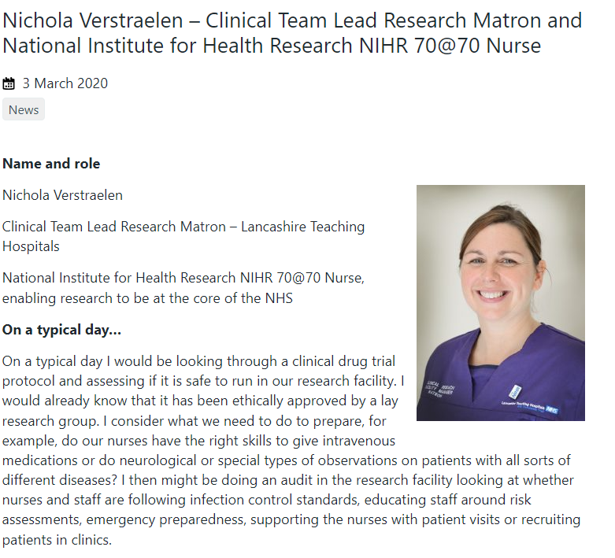
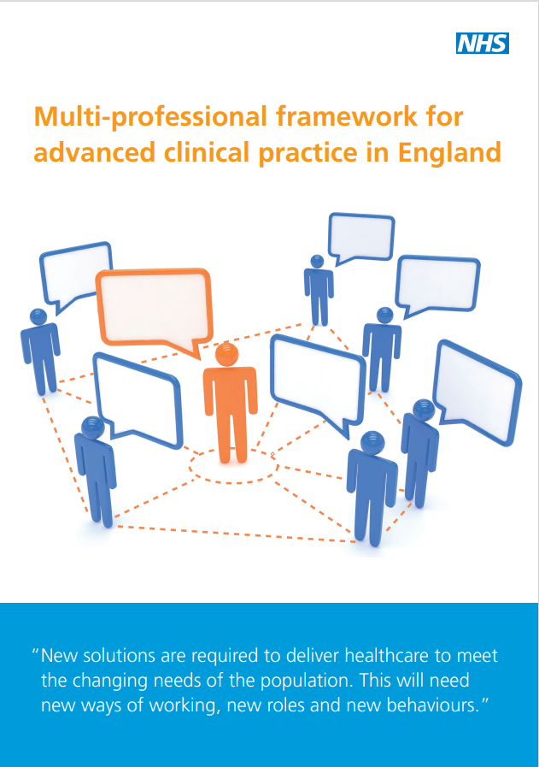
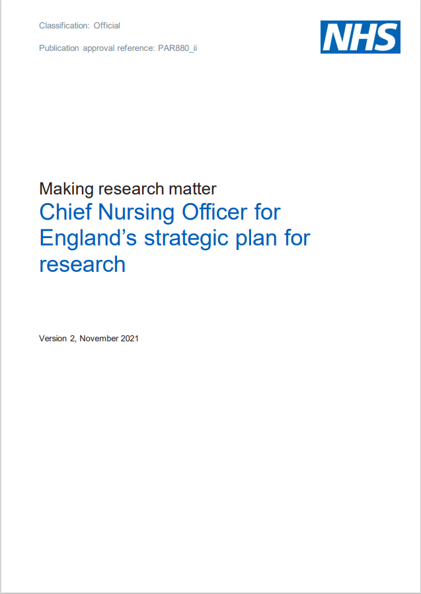
National Perspective
Notes:
Research Matrons toolkit
HEE pillars
Building
careers – links to NIHR
How we are going to use the positives from CNF Prog to evolve and develop, capturing the magic:
Positive : How use it:
Lighting fires Offer a range of research development opportunities for a range of staff (EBP, Research Champions)
Creating a community of practice Keep in touch with Alumni, alumni to become part of faculty (eg Claudio)
Nurturing research careers Support participants who wish to pursue a research career into the future (eg CATO Rich Holmes)
Quality improvement Promote the positive changes to practice
Academic development Support participants who wish to pursue academic careers into the future (eg CATO Jo Midgeley, Hannah Prince)
Leadership skills Develop and keep in touch with participants to monitor career development (eg Becky Mapson)
Change management skills Keep in touch with alumni (using Iris and regular get togethers)
Confidence Keep in touch with alumni to monitor progress eg conference presentations, publications
The Magic:
Individuality
Diversity
Community of Practice
Retention
Quality improvement in practice
Clinically focused – developing talent – the leaders of the future learning skills at the bedside

