Slide 1
Is it Research? QI? EBP?
Christina Koulouglioti PhD, RN
Senior Research Fellow
Research and Innovation Department
University Hospitals Sussex NHS Foundation Trust
Nov 24th, 2023

Slide 2
Benefits
Organisations strive to integrate Research, Quality Improvement, Evidence Based Practice (EBP), Clinical audit and service evaluation
Better patient outcomes
Reduce cost
Increase quality

Slide 3
Confusion
Confusion on methodological differences between Quality Improvement (QI), Evidence Based Practice (EBP) and Research
Because of the many overlapping features

Slide 4
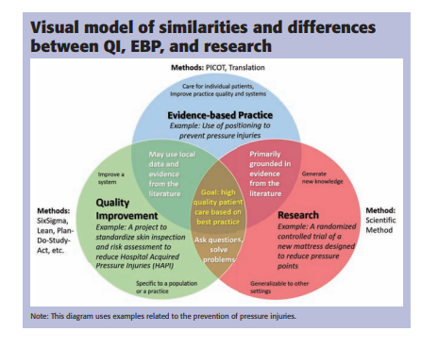
Grys CA. Evidence-based practice, quality improvement, and research: A visual model. Nursing. 2022 Nov 1;52(11):47-49. doi: 10.1097/01.NURSE.0000889812.89287.45. PMID: 36259907.

Slide 5
 | QI | EBP | Research
 | Systematic and continuous actions that lead to measurable improvement in health care services and the health status of targeted patient groups | EBP is healthcare delivery based on the integration of the best research evidence available combined with clinical expertise, in accordance with the preferences of the patient and family | Research is the “systematic investigation, including research development, testing and evaluation, designed to develop or contribute to generalizable knowledge”
Who benefits | Patients Clinicians Organisation | Patients Clinicians Organisation | Clinicians Scientific community Research participants (occasionally)
Purpose | Improve quality or safety of processes or patient experience within the local clinical setting Improve efficiency or flow Standardize work Improve patient care | Improve quality and safety within the local clinical setting by applying evidence in health care delivery Change Practice | Contribute / generate new knowledge that can be generalised
Scope of interest | Specific unit or patient population within an organisation | Specific unit or patient population within an organisation | Generalise to populations beyond the organisation

Slide 6
 | QI | EBP | Research
Methodology Processes and measures | Measures are simple and easy to use and administer Measures for key indicators only Measures developed locally | Measures include knowledge, attitude, behavior/practices, outcomes, and balancing measures Measures for key indicators using tools with face validity but may be without established validity or reliability | Measures are complex Measures take time to completed Measures require a protocol detailing how to administer Measures require preliminary tests of reliability, validity, specificity, and/or sensitivity
Design | Plan Do Study Act (PDSA) Lean Six Sigma | An EBP process model like the Iowa Model Johns Hopkins EBP model | Experimental Observational Descriptive Quantitative or Qualitative
Sample | Unit / ward level | Patient population | Representative
Ethics and HRA approval | Usually No | Usually No | Yes
University of Iowa Health Care, Nursing Research and EBP

Slide 7
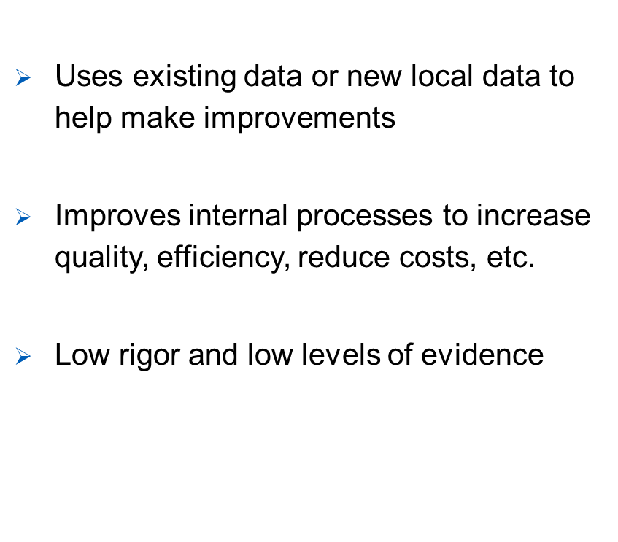
QI
It is NOT research
Originated from auto industry/ business domain
It is a DATA driven systematic approach
Focus WITHIN the organisation/department

Slide 8
QI Examples - Resources
Reduce wait time for OR patients
Increase customer satisfaction of A&E patients
Examining the use of a specific intervention at the ward/facility level in an attempt to reduce patient falls
Improving documentation of critical lab values
Homepage | BMJ Open Quality
QI-Innovation-Toolkit.pdf (nihr.ac.uk)

Slide 9
EBP Examples – Resources
Healthcare bundles for example:
Pressure ulcer prevention
Falls prevention
Restraint free environments
Safe patient handling
Homepage | BMJ Evidence-Based Medicine
Homepage | Evidence Based Nursing (bmj.com)
Home - 2020 - The Centre for Evidence-Based Medicine (cebm.net)
Iowa Model of Evidence-Based Practice: Revisions and Validation - PubMed (nih.gov)
Fuld National Institute for EBP | Helene Fuld Health Trust National Institute for Evidence-based Practice in Nursing and Healthcare (osu.edu)

Slide 10
Research Methodology
Research Question/Hypothesis
Literature review
Conceptual/theoretical model
Variables
Methods
Research design
Instrumentation
Data collection
Data analysis
Interpretation of Data-Results/Support or Refute questions/hypothesis
Implications for practice
Dissemination of findings

Slide 11
Clinical Audit
Clinical audit measures the quality of care and services against agreed standards, making improvements where necessary
Asks “does this service reach a predetermined standard”
NICE | The National Institute for Health and Care Excellence

Slide 12
Service evaluation
Service evaluations consider if existing or newly implemented services are effective. This process explores what is happening in a service as well as outcomes and experience for patients.
Asks “what standard does this service achieve”

Slide 13
Moving forward
Is not a question of using one or the other
All needed
Different skills for each approach
All important

Slide 14
Thank you and Questions

